Slide 1

Dynamic Imaging Particle Analysis
Data Center Coolants
JM Canty, Inc. · Buffalo, New York · Phone: (716) 625-4227 | JM Canty, Ltd. · Dublin, Ireland · Phone: +353 (1) 882-9621

Slide 2

Migration to Liquid Cooling
As computing power increases at an almost exponential rate, heavily driven by the increased adoption of AI and expansion of cloud computing, it has massively driven up equipment cooling requirements.
While traditional racks often operated at 5–10 kW, modern AI optimized racks now commonly require 40–60+ kW, and projections indicate that leading-edge, liquid-cooled racks will soon reach 100–600+ kW per rack.
JM Canty, Inc. · Buffalo, New York · Phone: (716) 625-4227 | JM Canty, Ltd. · Dublin, Ireland · Phone: +353 (1) 882-9621

Slide 3
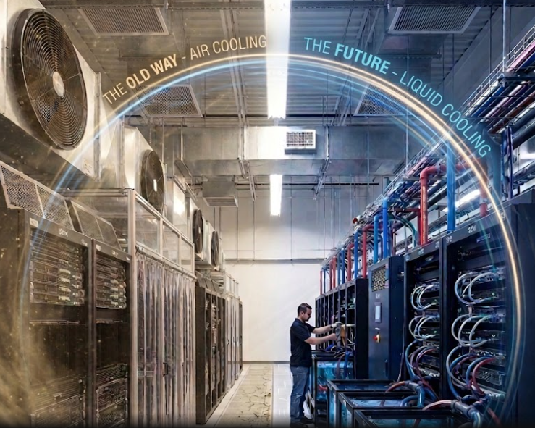
Migration to Liquid Cooling
Historically common air cooling systems simply cannot handle such a heat load, which has accelerated the move towards liquid based cooling systems
JM Canty, Inc. · Buffalo, New York · Phone: (716) 625-4227 | JM Canty, Ltd. · Dublin, Ireland · Phone: +353 (1) 882-9621

Slide 4


Current Industry Guidelines and Standards
The industry is moving quickly, and existing standards and guidelines are primarily written around air cooling systems, with large gaps related to liquid cooled systems
American Society of Heating Refrigerating and Air-Conditioning Engineers
TC 9.9 deals with Data Centre cooling
Members / contributors include global leading companies in IT software / hardware companies as well as cooling system hardware and coolant chemical manufacturers
Last document published in 2021
Updated version with heavy focus on liquid cooling expected in 2026-2027
Not a formal standards body, and is more a collaborative community working on an area of common interest
Similar membership profile as ASHRAE
Publish more regular recommendations or guidelines than ASHRAE
JM Canty, Inc. · Buffalo, New York · Phone: (716) 625-4227 | JM Canty, Ltd. · Dublin, Ireland · Phone: +353 (1) 882-9621

Slide 5
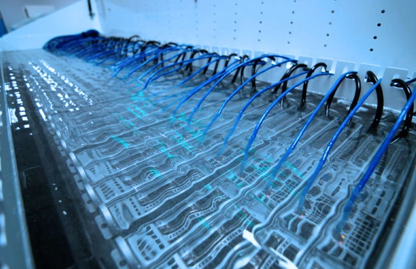
Types of Liquid Cooling
Direct to Chip
Immersion
Cold plate through which coolant flows in micro channels, is mounted onto the chip itself
Entire Rack is submerged in coolant
JM Canty, Inc. · Buffalo, New York · Phone: (716) 625-4227 | JM Canty, Ltd. · Dublin, Ireland · Phone: +353 (1) 882-9621

Slide 6
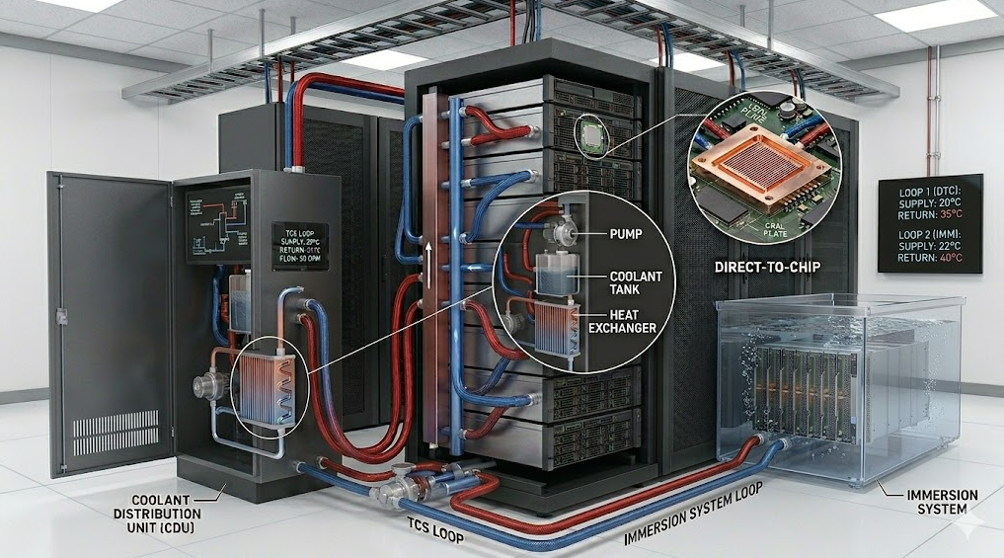
Types of Liquid Cooling
Technology Cooling System (TCS) loops, circulate liquid coolant between a Coolant Distribution Unit (CDU) and the Cold Plates or the Immersion Bath
JM Canty, Inc. · Buffalo, New York · Phone: (716) 625-4227 | JM Canty, Ltd. · Dublin, Ireland · Phone: +353 (1) 882-9621

Slide 7
Coolant Properties
The properties of the coolant fluid are critical, in order to ensure maximum heat transfer from the rack. Multiple parameters of the fluid require analysis;
Ethylene Glycol or Propylene Glycol Concentration (water / glycol mix)
pH
Hardness
Sulfate Concentration
Chloride Concentration
Suspended Particulate Size and Concentration
JM Canty, Inc. · Buffalo, New York · Phone: (716) 625-4227 | JM Canty, Ltd. · Dublin, Ireland · Phone: +353 (1) 882-9621

Slide 8
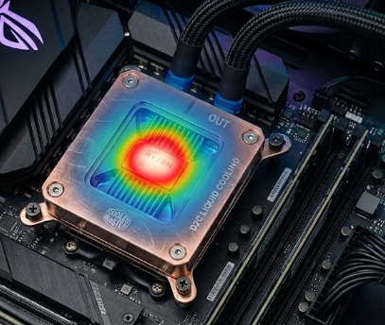
Particle Contamination Issues
Specifically for Direct to Chip Cooling;
Clogging of Micro Channels: Given the small size (100 – 500 micron), even minor particulate matter can plug these channels, causing severe, localized hot spots on the chip, leading to thermal throttling or catastrophic failure.
Reduced Cooling Efficiency: Even before completely plugging a channel, as particles accumulate, they create insulating layers that reduce heat transfer efficiency. This forces cooling pumps to work harder and increases the overall thermal resistance of the system.
JM Canty, Inc. · Buffalo, New York · Phone: (716) 625-4227 | JM Canty, Ltd. · Dublin, Ireland · Phone: +353 (1) 882-9621

Slide 9
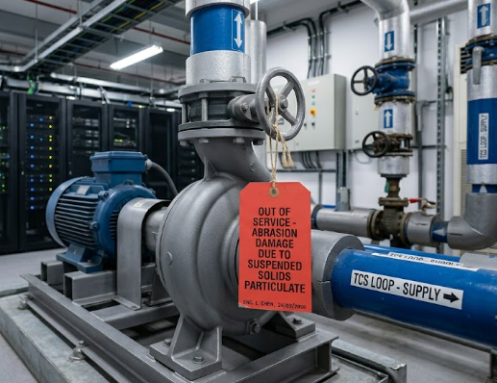
Particle Contamination Issues
Direct to Chip and Immersion Cooling Systems;
Accelerated Corrosion: Particle contamination, especially when combined with moisture, accelerates corrosion throughout the cooling loop. Corrosive byproducts can create sludge, leading to further clogging, or pit the cold plates, causing coolant leaks and premature failure of pumps and heat exchangers.
Abrasive Pump Wear: Impurities in the coolant act as abrasives that cause premature wear and failure of pumps and valves within the liquid cooling unit (CDU).
JM Canty, Inc. · Buffalo, New York · Phone: (716) 625-4227 | JM Canty, Ltd. · Dublin, Ireland · Phone: +353 (1) 882-9621

Slide 10
Particle Contamination Sources
Corrosion Byproducts
Metallic particles from pipes and connectors.
Environmental Debris
Dust or other materials entering during maintenance
Manufacturing Residue
Leftover materials from the construction of the cooling hardware
Biological Growth Bacteria or algae in the cooling fluid.
JM Canty, Inc. · Buffalo, New York · Phone: (716) 625-4227 | JM Canty, Ltd. · Dublin, Ireland · Phone: +353 (1) 882-9621

Slide 11
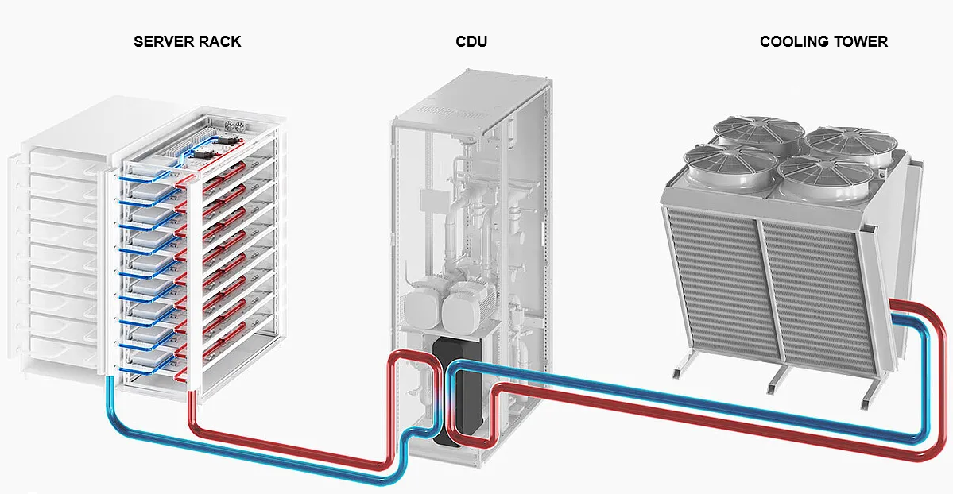
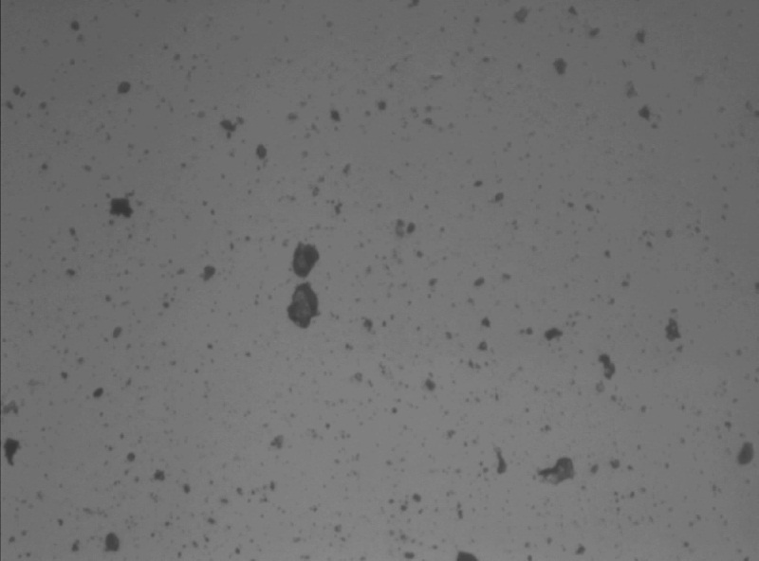
Target Application 1 – Particle Analysis on TCS Loops
Real time particle analysis on the TCS loop allows for;
Maintenance / replacement schedule planning on filtration equipment and the coolant itself
Instantaneous detection of any filter breakthrough or failure
JM Canty, Inc. · Buffalo, New York · Phone: (716) 625-4227 | JM Canty, Ltd. · Dublin, Ireland · Phone: +353 (1) 882-9621

Slide 12
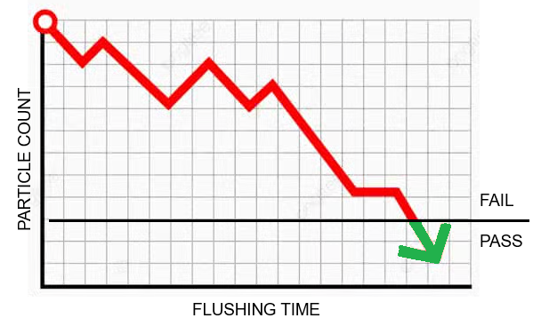
Target Application 2 – Particle Free TCS Hardware Supply
Prior to delivery of TCS loop hardware (heat exchanger, tanks, piping, pumps etc.) the manufacturer must ensure the equipment is particle free.
The last manufacturing step is flushing the equipment with a cleaning fluid to remove suspended particles.
Monitoring the particle concentration in the flushing fluid discharge can determine when the equipment is particle free.
JM Canty, Inc. · Buffalo, New York · Phone: (716) 625-4227 | JM Canty, Ltd. · Dublin, Ireland · Phone: +353 (1) 882-9621

Slide 13
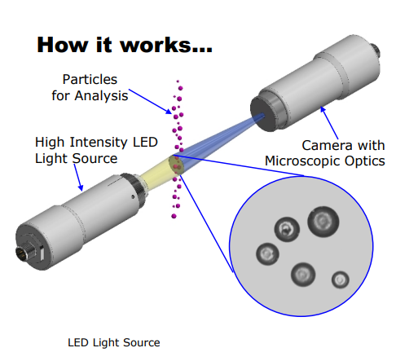
The Solution: Dynamic Imaging Particle Analysis
Basic principle of flowing the coolant fluid between a high intensity light source, and microscopic camera
The captured images are analysed in realtime by Cantyvision software, where they are measured under 40+ different size and shape parameters (major axis, minor axis, area, perimeter, circularity, aspect ratio….)
JM Canty, Inc. · Buffalo, New York · Phone: (716) 625-4227 | JM Canty, Ltd. · Dublin, Ireland · Phone: +353 (1) 882-9621

Slide 14
The InFlow Analyser
Gigabit Camera with Microscopic Lens
LED Light Source
Flow Cell
Coolant In
JM Canty, Inc. · Buffalo, New York · Phone: (716) 625-4227 | JM Canty, Ltd. · Dublin, Ireland · Phone: +353 (1) 882-9621

Slide 15
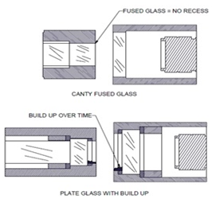
The InFlow Analyser
Uncompressed GigE video combined with 4K lens for optimum image capture
Particle / Droplet Size to 1 - 295µm
Particle / Droplet Concentration: 0 – 2500 ppm(v) or 0 – 500,000 ppml
High Intensity (2000 Lumen) LED Light Source
50,000 Hours (5+ years) Continuous Use
Fused Glass Process Barrier;
- No dead space for particulate to be trapped
- No window gasket = ZERO chance of leaks
JM Canty, Inc. · Buffalo, New York · Phone: (716) 625-4227 | JM Canty, Ltd. · Dublin, Ireland · Phone: +353 (1) 882-9621

Slide 16
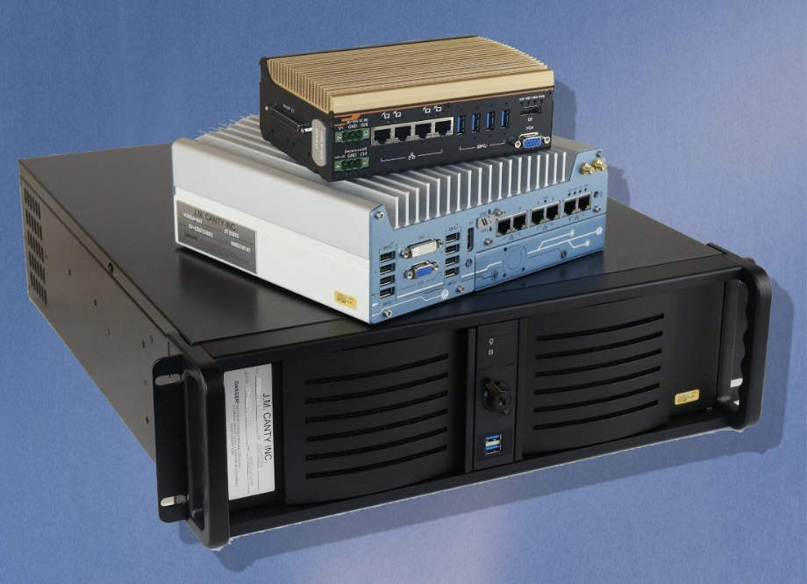
Vector Control Module (VCM)
Uses CantyVision analysis software to process the live video feed from the InFlow, and provide detailed analysis of the suspended particulate size and concentration
Multiple outputs
Video Display
4-20mA
OPC
MODBUS (TCP/IP or RTU)
Ease of Remote Support
JM Canty, Inc. · Buffalo, New York · Phone: (716) 625-4227 | JM Canty, Ltd. · Dublin, Ireland · Phone: +353 (1) 882-9621

Slide 17
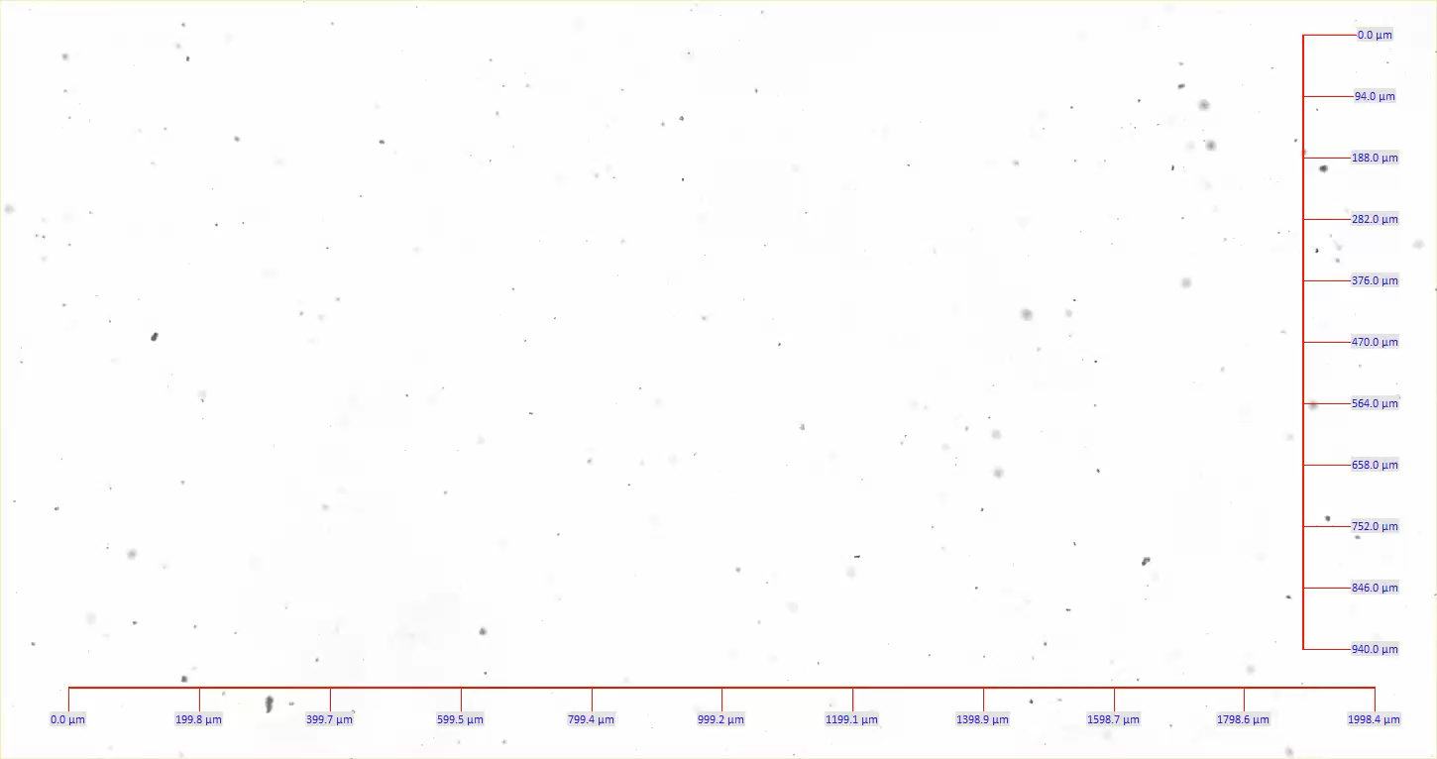
JM Canty, Inc. · Buffalo, New York · Phone: (716) 625-4227 | JM Canty, Ltd. · Dublin, Ireland · Phone: +353 (1) 882-9621

Slide 18
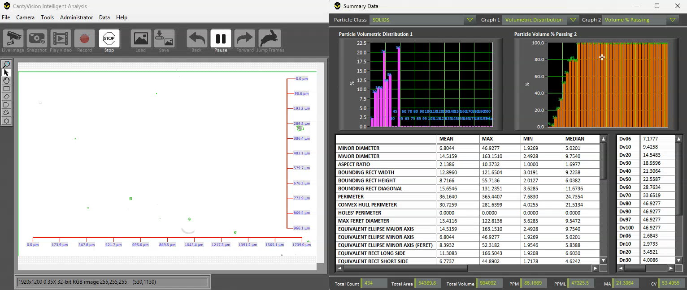
Analysis Interface 1 - Summary
PPM AND PPML DATA
JM Canty, Inc. · Buffalo, New York · Phone: (716) 625-4227 | JM Canty, Ltd. · Dublin, Ireland · Phone: +353 (1) 882-9621

Slide 19
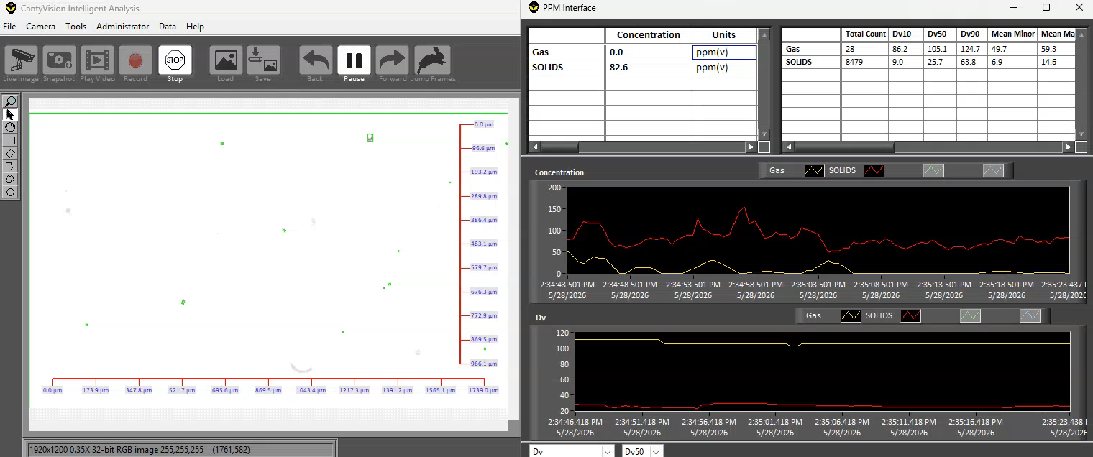
Analysis Interface 2 – PPM Concentration
JM Canty, Inc. · Buffalo, New York · Phone: (716) 625-4227 | JM Canty, Ltd. · Dublin, Ireland · Phone: +353 (1) 882-9621

Slide 20
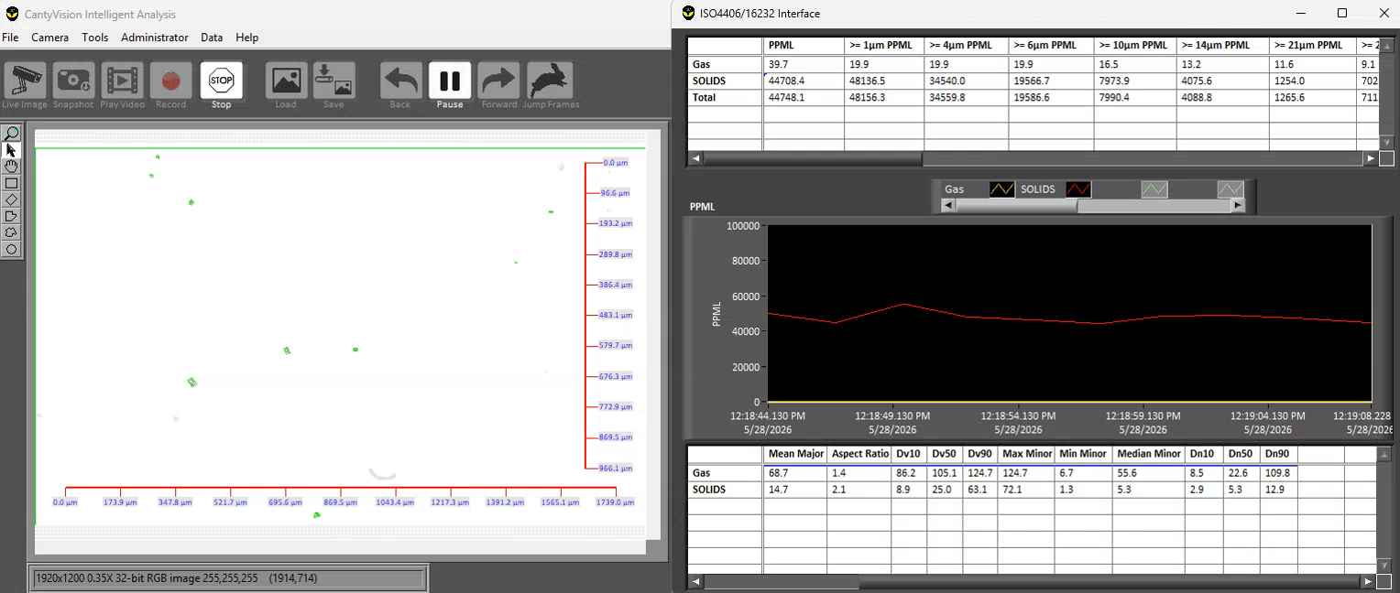
Analysis Interface 3 – ISO PPML Counts
JM Canty, Inc. · Buffalo, New York · Phone: (716) 625-4227 | JM Canty, Ltd. · Dublin, Ireland · Phone: +353 (1) 882-9621

Slide 21
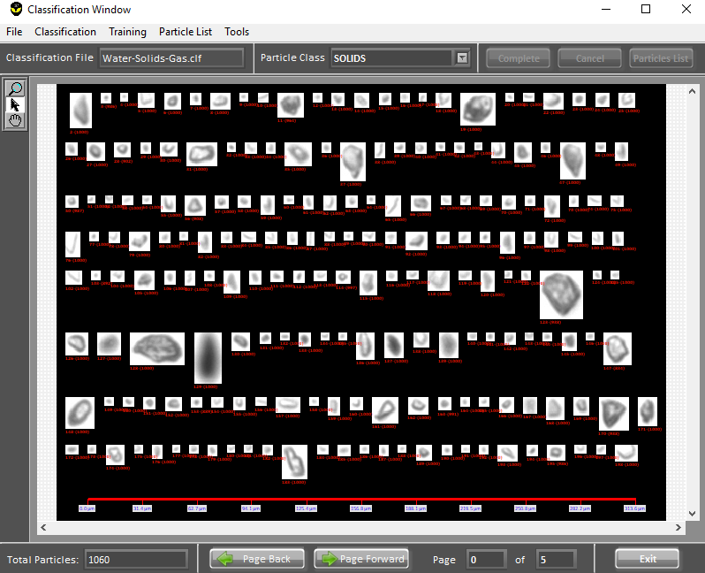
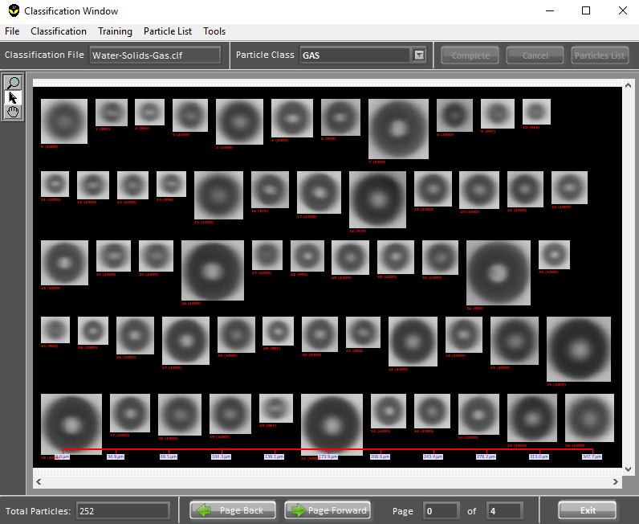
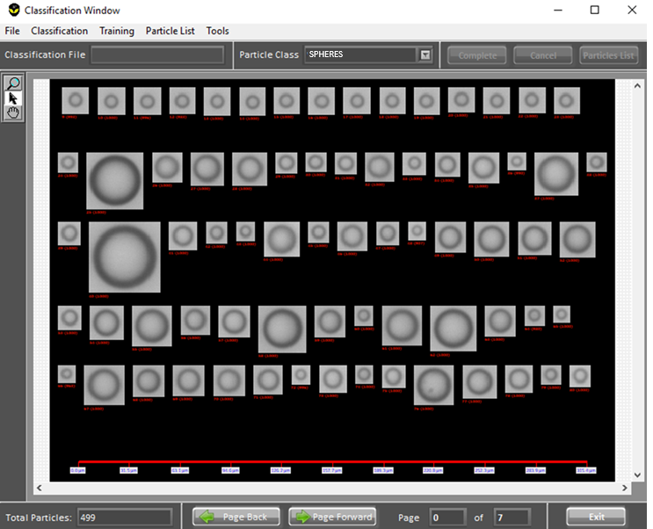
Particle Classification
Classification feature provides separate size / count / concentration outputs for each particle type present in the cooling fluid
Suspended Solids
Air Bubbles
Oil (Leak from Pumps)
JM Canty, Inc. · Buffalo, New York · Phone: (716) 625-4227 | JM Canty, Ltd. · Dublin, Ireland · Phone: +353 (1) 882-9621

Slide 22
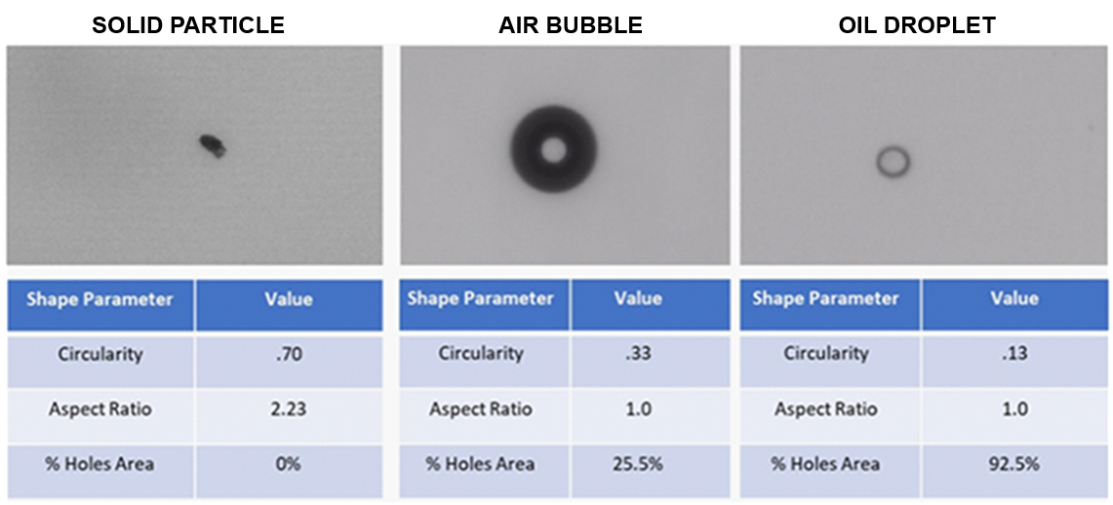
Particle Classification
Visual differences in particle types are recognised due to the multi-dimensional size and shape measurement performed
JM Canty, Inc. · Buffalo, New York · Phone: (716) 625-4227 | JM Canty, Ltd. · Dublin, Ireland · Phone: +353 (1) 882-9621

Slide 23

Route to Market
Coolant Chemical Manufacturers
TCS Cooling Loop Hardware Manufacturers
Data Centre Operations Facilities Teams
Data Centre Engineering
Design Companies
JM Canty, Inc. · Buffalo, New York · Phone: (716) 625-4227 | JM Canty, Ltd. · Dublin, Ireland · Phone: +353 (1) 882-9621

Slide 24
This concludes the Presentation!
Thanks for choosing CANTY!
For Further Information on this product please visit www.jmcanty.com.
JM Canty, Inc. · Buffalo, New York · Phone: (716) 625-4227 | JM Canty, Ltd. · Dublin, Ireland · Phone: +353 (1) 882-9621

